Slide 1
Sentiment Analysis of Tweets
Yadav, Hitesh (hitesh2@illinois.edu)
Srinivasan, Gopikrishnan (gs25@illinois.edu)
Bhaskar, Shubhendu (sb59@illinois.edu)
Goel, Chandan (chandan3@illinois.edu)
Singh,Sanjeev (sksingh6@illinois.edu)

Slide 2
Problem
A tweet is a post on Twitter. Tweets can be up to 140 characters long, including spaces, and can include URLs and hashtags.
Twitter messages include sarcasm, slang, irony, jargon contraction of existing words, abbreviations, acronyms, amplifications, new words, emoticons and various types of punctuation.
With such complexity of the text data we need some well-developed methodology for the classification of texts at various levels (tweet, sentence, blog, document etc.) according to their attitude polarity, or affect and emotion content(Ref: https://www.sciencedirect.com/science/article/pii/S0166361520305339)

Slide 3
Overview
Sentiment analysis refers to identifying as well as classifying the sentiments that are expressed in the text source. Texts are classified as positive, negative or neutral.
The application developed allows user to enter a text on the screen and computationally determines the sentiment of the tweet for the intended audience .
This tool can be used by different stake holders in overviewing the sentiments for a specific objective and understanding the generic opinion trend

Slide 4
Data
Kaggle is used as the dataset for building the model
Only columns chosen are “target” and “text”; the other columns like user, ids, date etc. are irrelevant in sentiment prediction therefore, these columns in the datasets are ignored.
Replaced the target code of “positive” tweets from “4” to “1“. Negative tweets are still represented by 0.

Slide 5
Model Comparison
To compare different models based on their performance, ROC curves for 5 different models were generated. Based on the ROC plots shown below, it was confirmed that for Twitter Sentiment Analysis, Logistic Regression model is the best suited model as compared to the other models.
Following were the models chosen for comparison:
Gaussian Naïve Bayes
Logistic Regression
Decision Tree Classifier
Random Forest Classifier
K-Neighbors Classifier

Slide 6
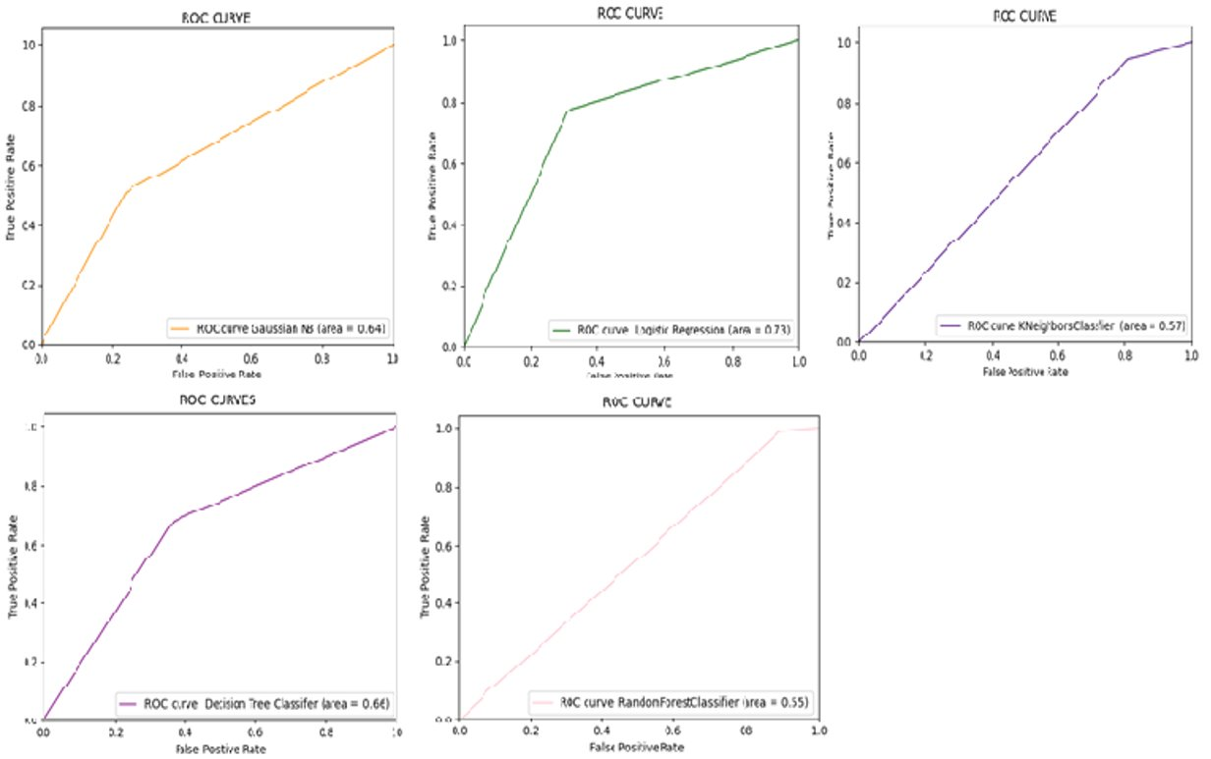
Model Comparison(Continued..)

Slide 7
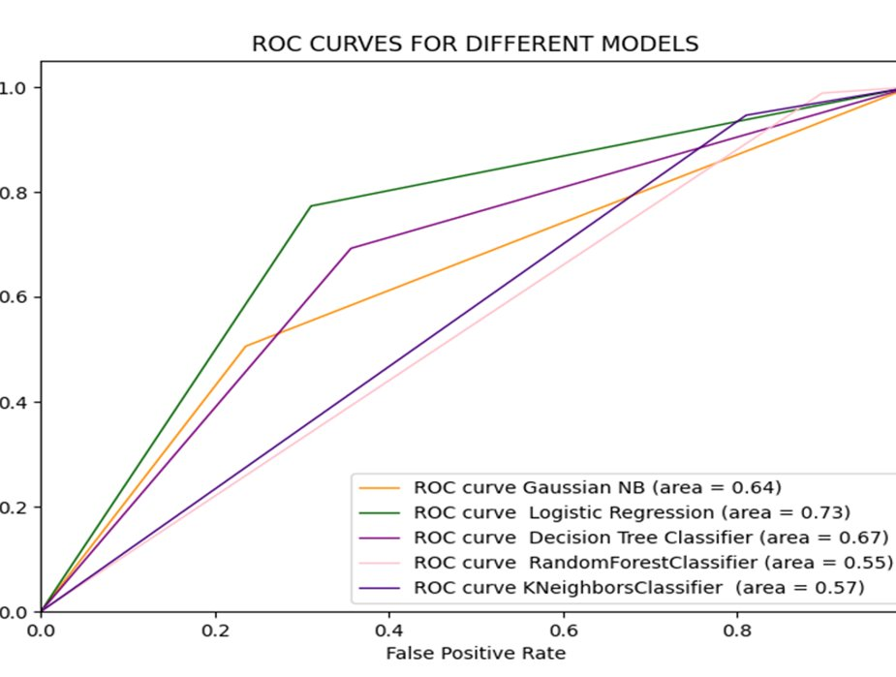
Model Comparison Conclusion
The order of ROC AUC Score for the models: Logistic Regression (0.73) > Decision Tree Classifier (0.67) > Gaussian NB (0.64) > K-Neighbors Classifier (0.57) > Random Forest Classifier (0.55)
Logistic Regression model preformed best with 73% chance . Therefore Logistic Regression model is used for generating our sentiment analysis

Slide 8
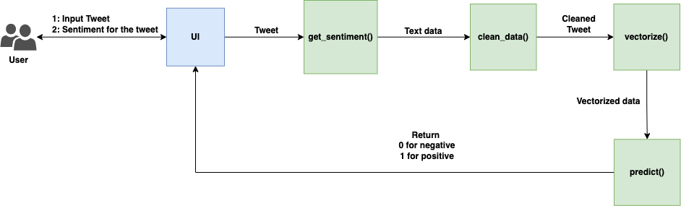
High Level Architecture

Slide 9
How to run the application?
Download the code from the link. As shown below root directory has two folders “backend” and “frontend”
“backend” folder contains the code of sentimental analysis engine while “frontend” holds UI code
Install the required dependencies using “pip install -r requirements.txt” command. File “requirements.txt” lists the dependencies along with the version.
Go to the directory backend “cd backend”
Run the modules of Natural Language Toolkit: “python nltk_modules.py”
Run the server using “python server.py”
Go back one level from the current “backend” directory using “cd..” and then change the current directory to “frontend”: “cd frontend”
Install npm: “npm install”
Run the app: “npm start”
Fire up a browser and hit the url http://localhost:3000

Slide 10
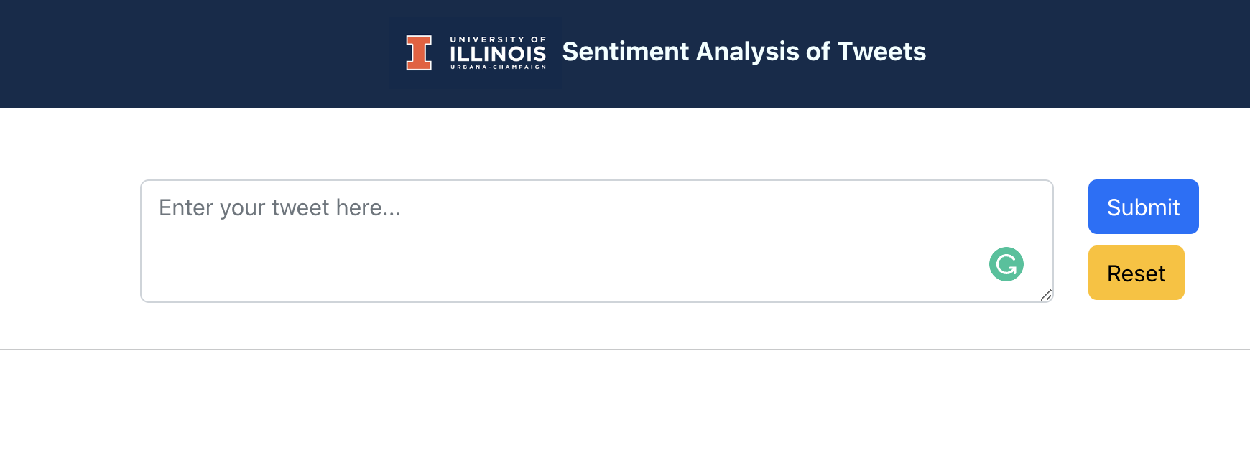
How to run the application?
The user is required to enter the tweet in the provided text box. Click the “Submit” button to analyze the tweet and produce the corresponding analysis output. ​

Slide 11


Demo

